Slide 1
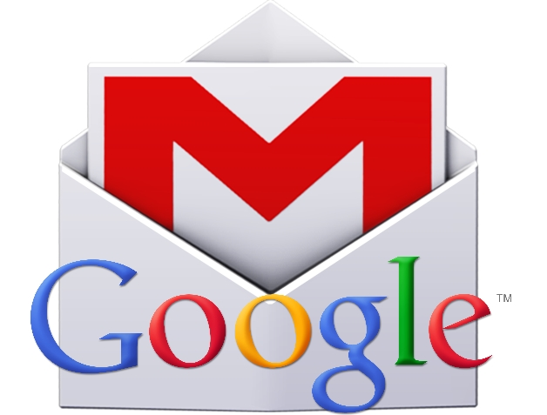
Working with Google Applications Gmail, a popular email
Notes:
slides 10-15 - 15 minutes Google applications or apps are free programs that you can use once you have established a google account. These programs can be used on your chromebook, a computer, or your smartphone.

Slide 2
What’s email and why use it?
Email is short for Electronic mail - a fast, easy, and inexpensive way to communicate with family, friends, and colleagues.
Email messages are sent from one person to another via a computer or mobile device such as a phone.
Email is more professional than a text - it is used in business.
The email message typically contains text, but can also contain files, images, or music
Notes:
Differences between email and texting Ask parents if they are using email now?

Slide 3
EMail Safety Tips
Always log off your email account and close the browser completely when using a public computer.
Don’t click on links in email unless you are certain of the url.
Don’t open files with the extension .exe, .zip, or .scr
Do not email anyone your bank account, social security number or credit card numbers
Remember not everything is true – hoaxes sent via email are very common.
Avoid Sweepstakes and Surveys.
Never buy from or reply to a Spam email.
Notes:
You will be getting directions for creating and using your email account, and we will be offering a class onXXXX

Slide 4
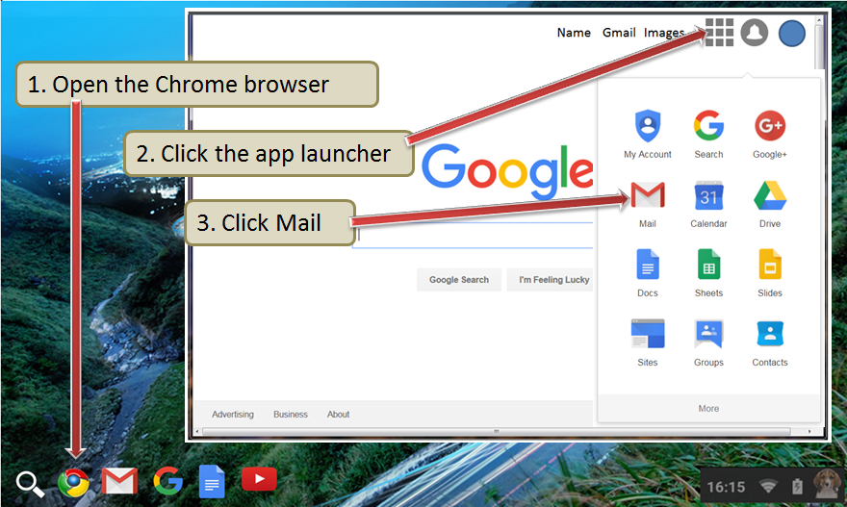
Google Gmail App
Notes:
Briefly talk about apps –have the users click on the Google icon and then click on apps icon in the top right corner. Emphasize Gmail, Drive, Translate, Calendar, maps.
Click on gmail icon

Slide 5
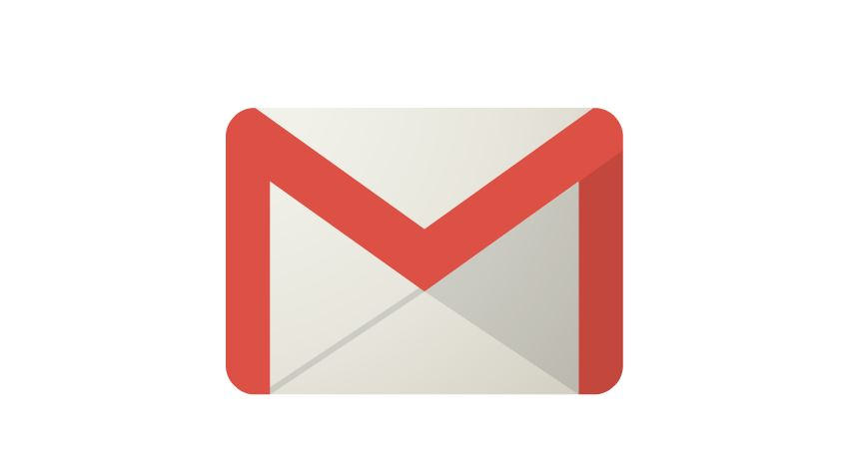
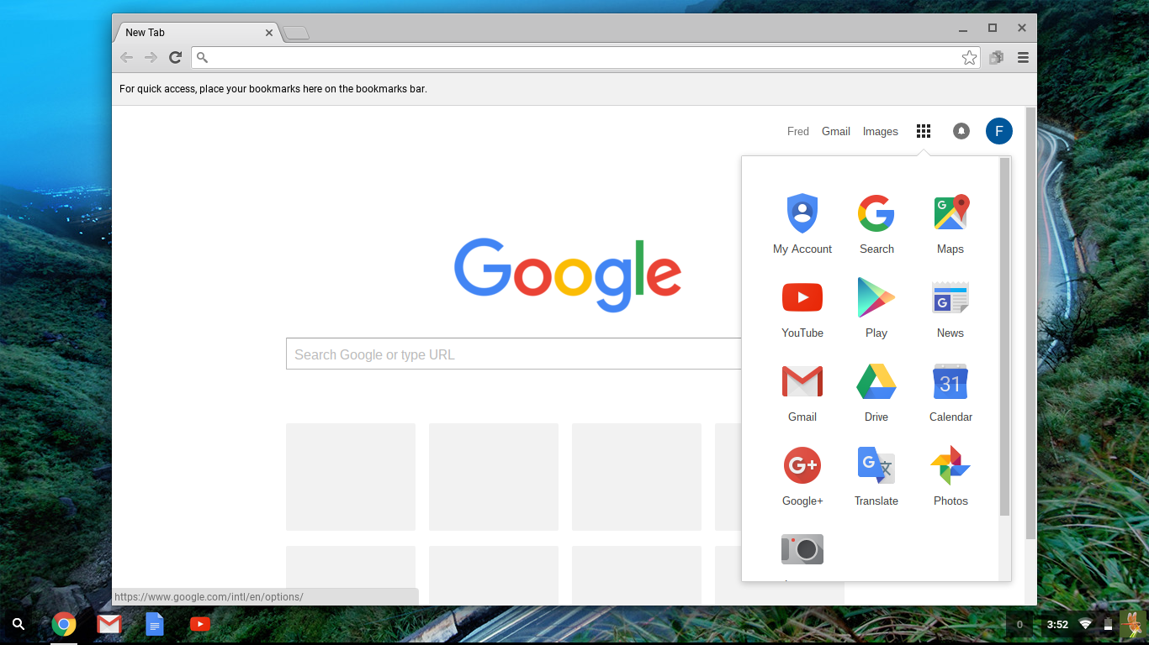
Using Google’s Gmail
*Click on the below link for more information on using Gmail
Email and Google Gmail
Notes:
slides 16- Click on gmail icon. Briefly talk about gmail, let them know that if they create a Google account, it will automatically create a gmail address for them too.

Slide 6
Notes:
End of class 1. Ask if there are any questions or comments.

